Slide 1
Churn modeling
Mnar salah ashry
Merna mourad Khalil
Kenzy aggour
Alaa elsaid elpaaly

Slide 2
Domain of the dataset
This data set contains details of a bank's customers and the target variable is a binary variable reflecting the fact whether the customer left the bank (closed his account) or he continues to be a customer.
Each row represents a bank customer, each column contains customer’s attributes described on the column Metadata.
The data set includes information about:
Customers who left bank – the column is called "Exited"
Customer account information that each customer has 'creditscore', 'balance', 'numofproducts', 'hascrcard', 'isactivemember'.
Demographic info about customers – surname, geography, gender, age range, tenure and 'estimatedsalary'.

Slide 3
Row Number: Row Numbers from 1 to 10000
Customer Id: Unique Ids for bank customer identification
Surname: Customer's last name
Credit Score: Credit score of the customer
Geography: The country from which the customer belongs
Gender: Male or Female
Age: Age of the customer

Slide 4
Tenure: Number of years for which the customer has been with the bank
Balance: Bank balance of the customer
NumOfProducts: Number of bank products the customer is utilizing
Has Cr Card: Binary Flag for whether the customer holds a credit card with the bank or not
Is Active Member: Binary Flag for whether the customer is an active member with the bank or not
Estimated Salary: Estimated salary of the customer in Dollars
Exited: Binary flag 1 if the customer closed account with bank and 0 if the customer is retained

Slide 5
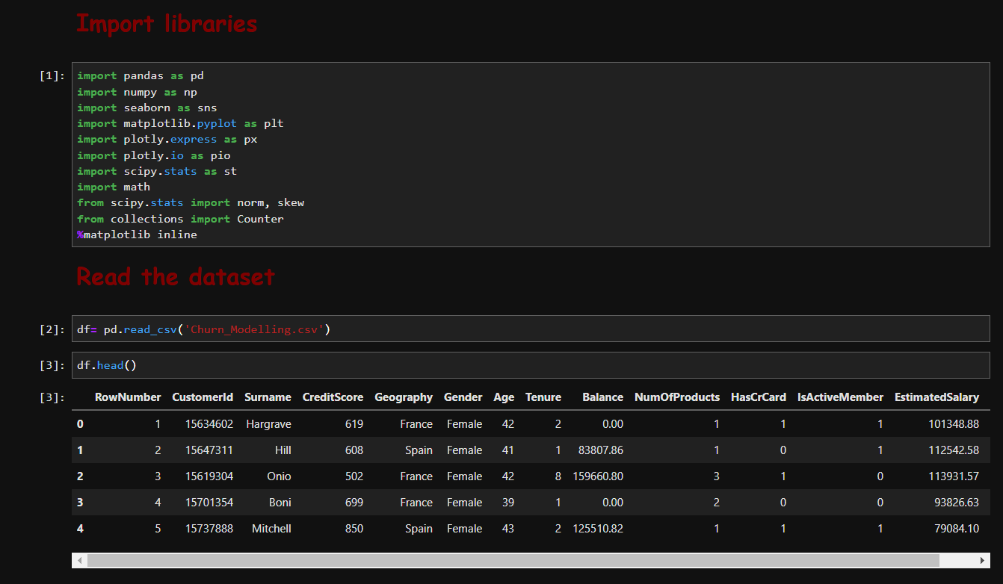
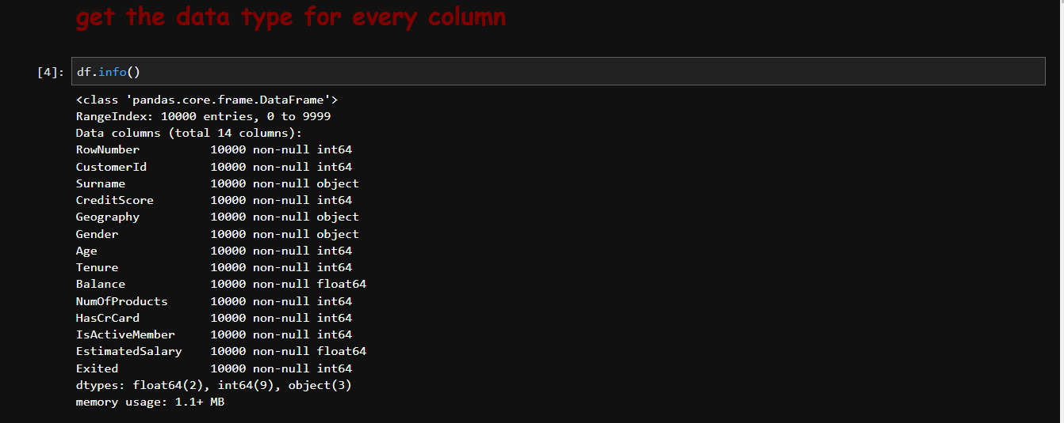

Slide 6
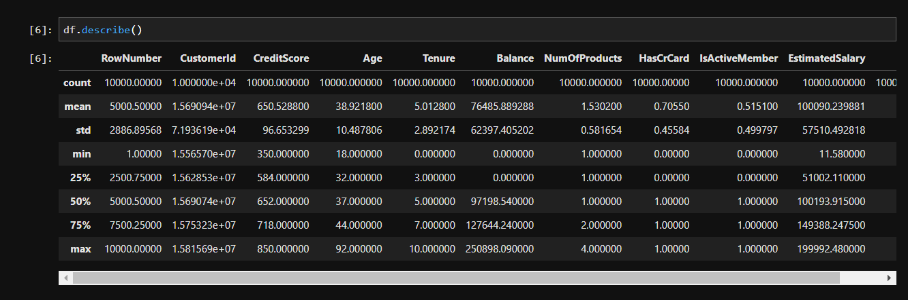
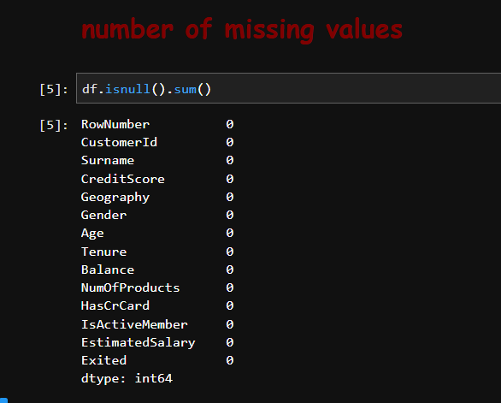

Slide 7
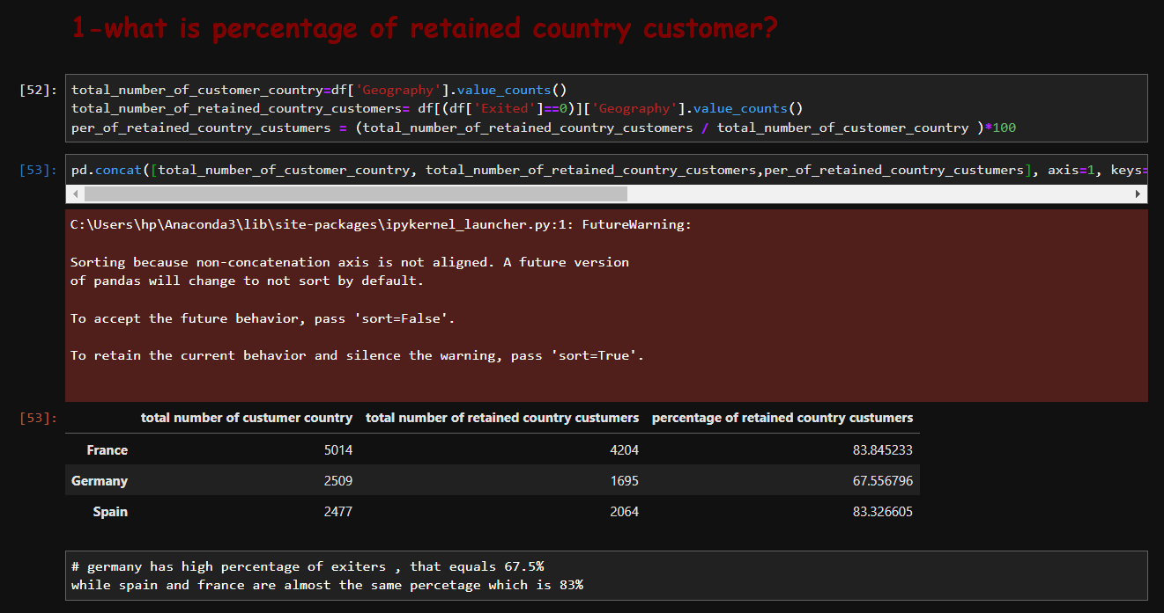

Slide 8
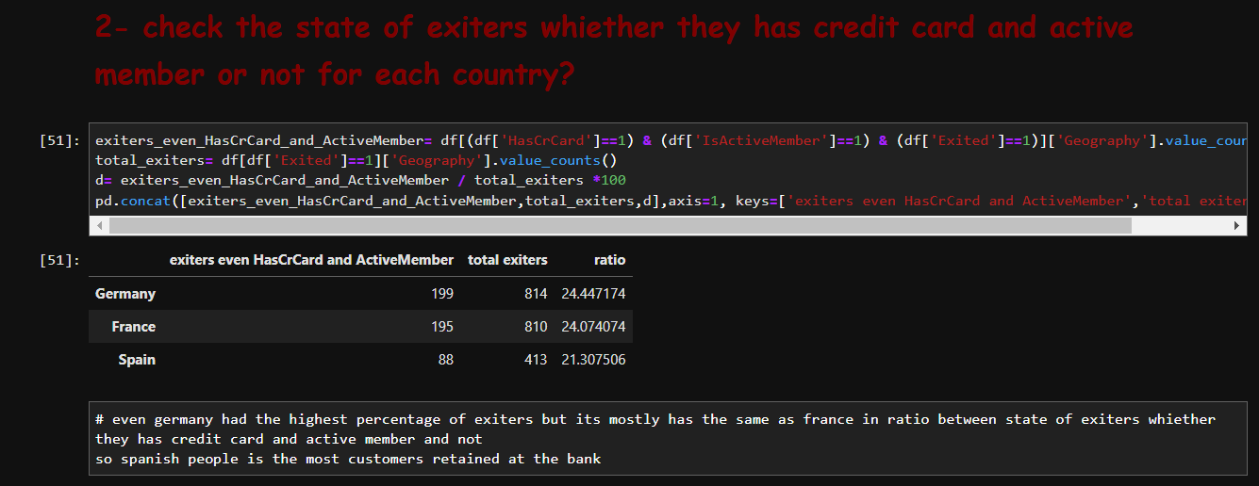

Slide 9
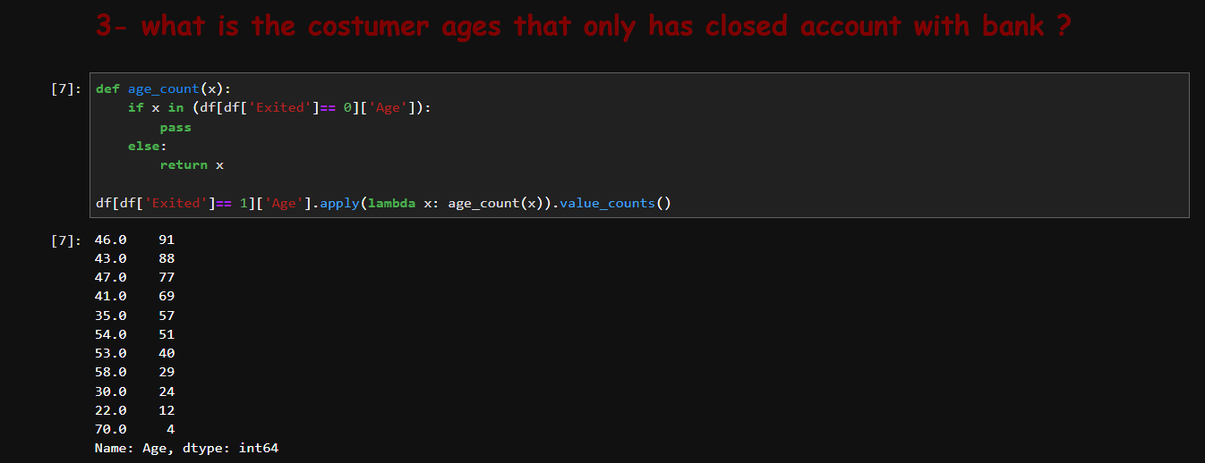

Slide 10
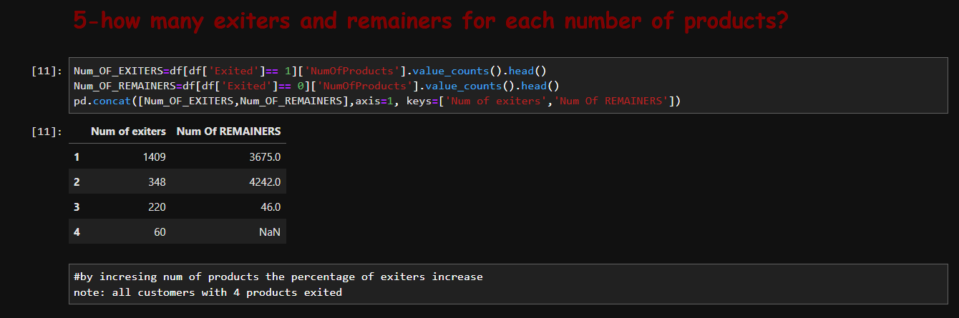

Slide 11
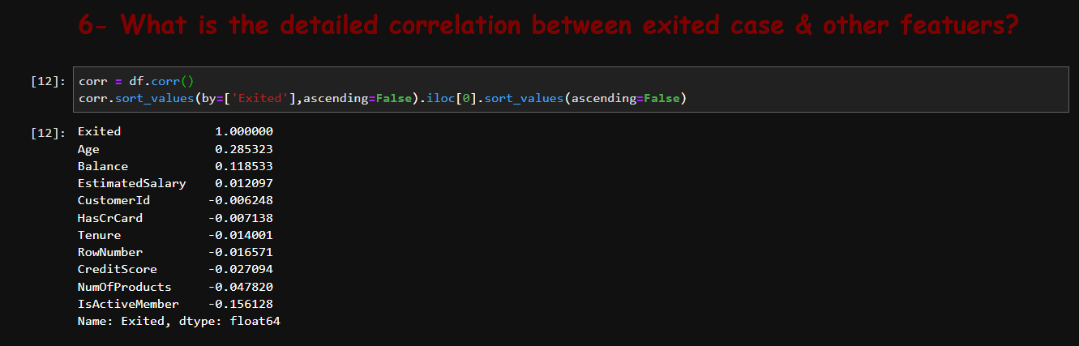

Slide 12
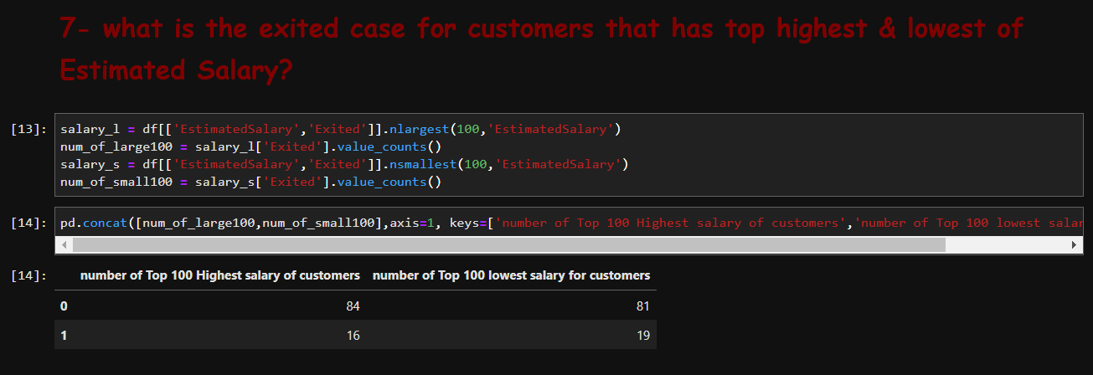

Slide 13
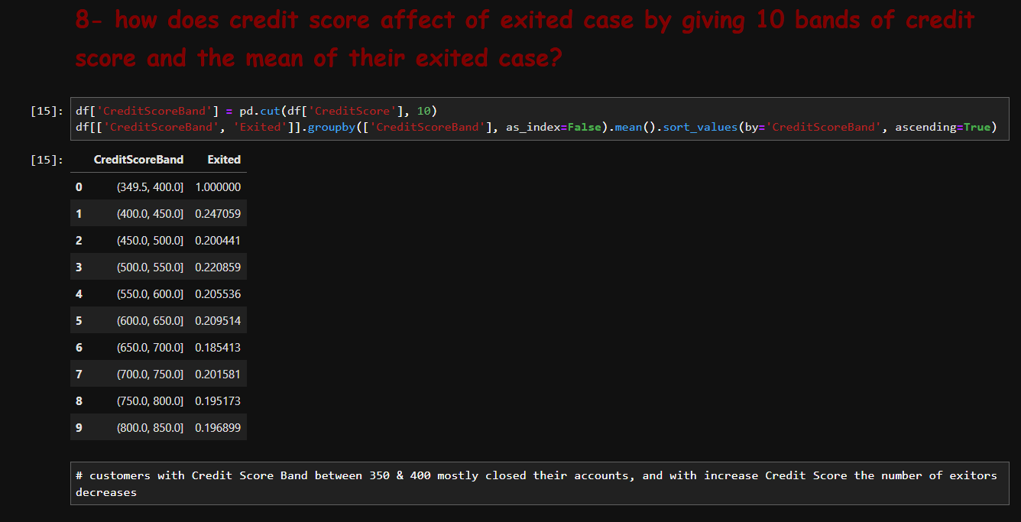

Slide 14
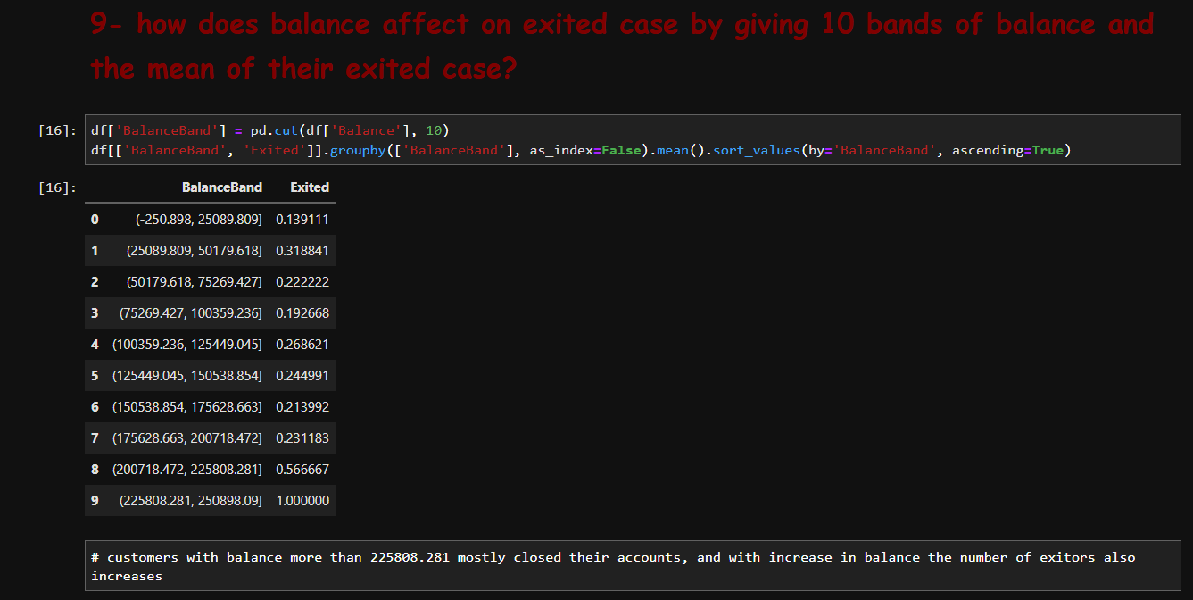

Slide 16
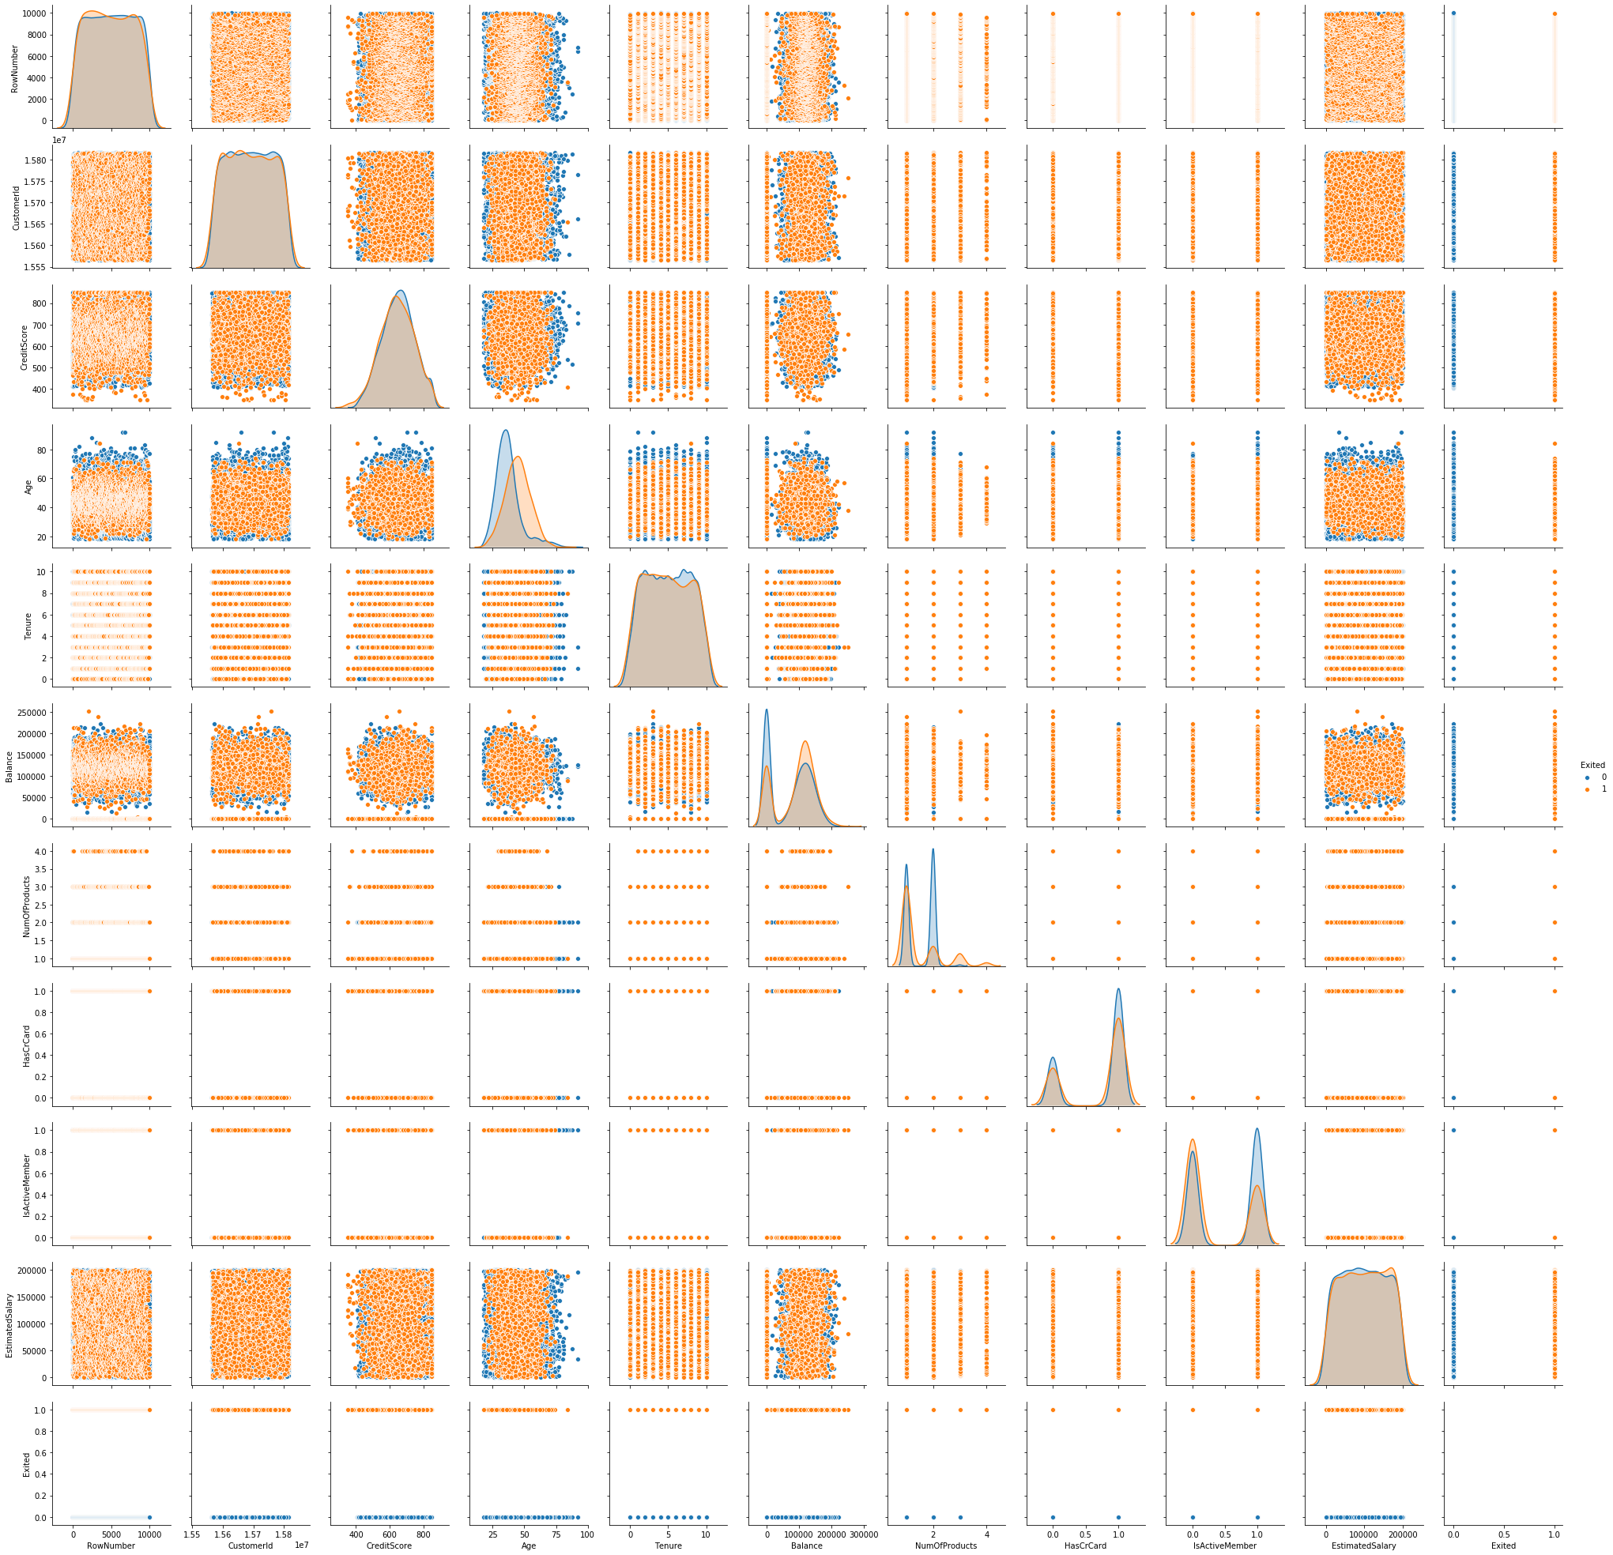

Slide 17
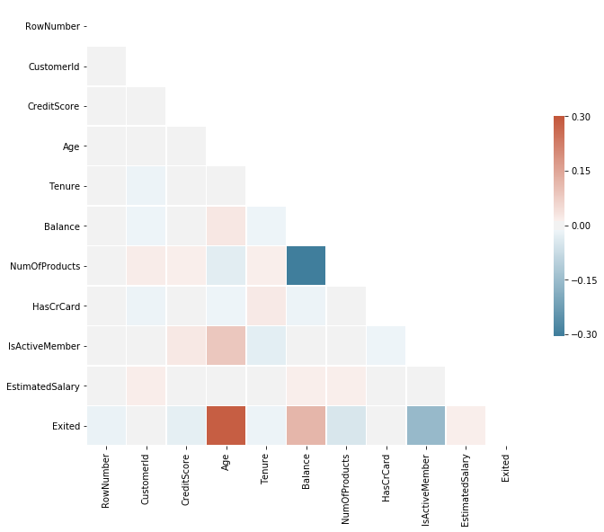

Slide 18
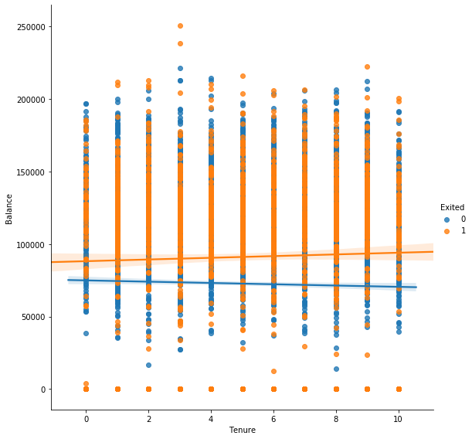

Slide 19
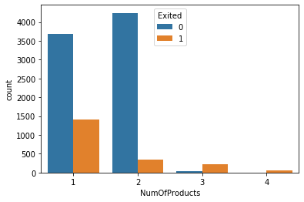
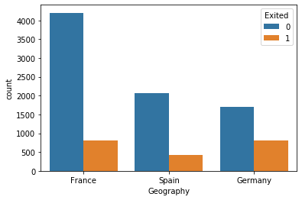

Slide 20
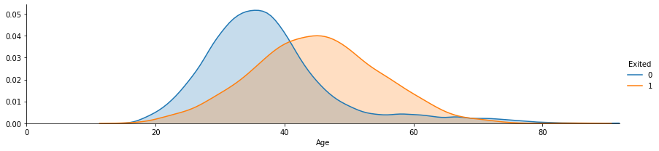
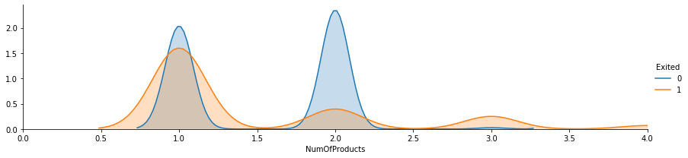

Slide 21
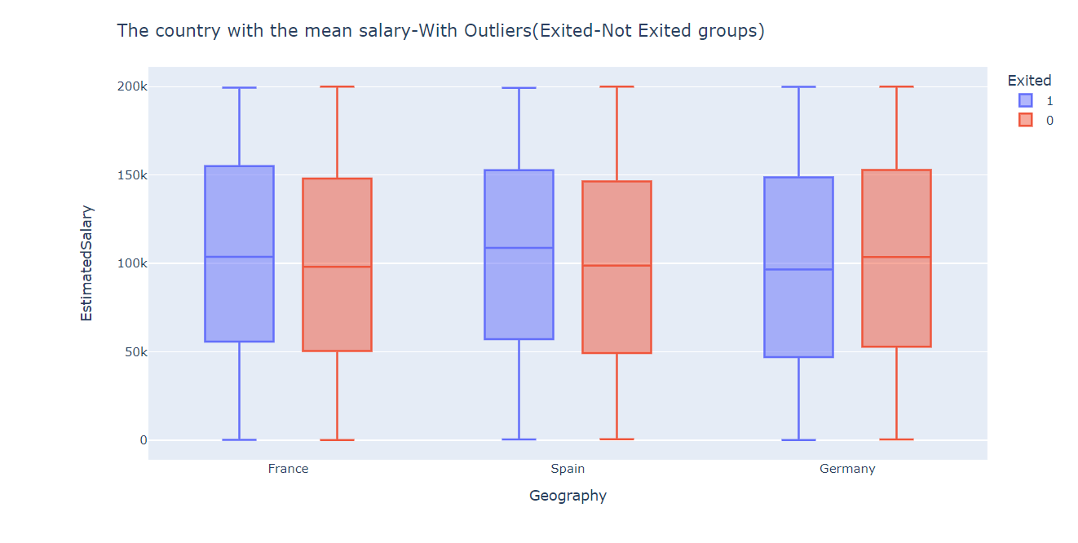

Slide 22
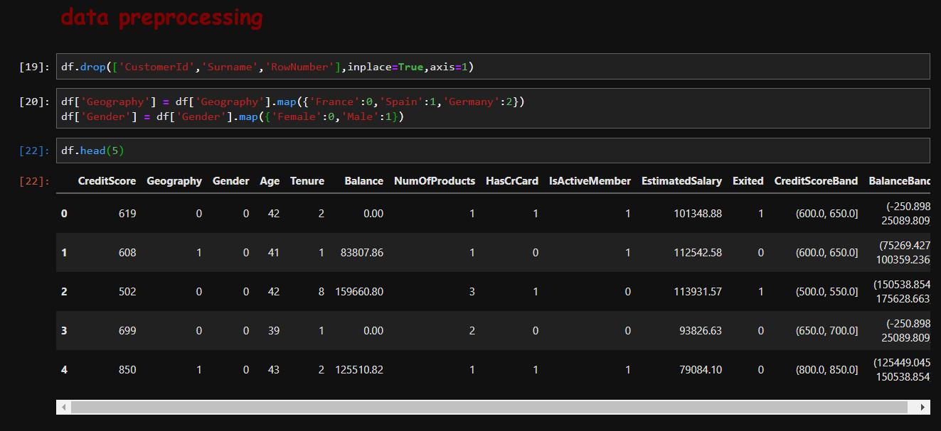

Slide 23
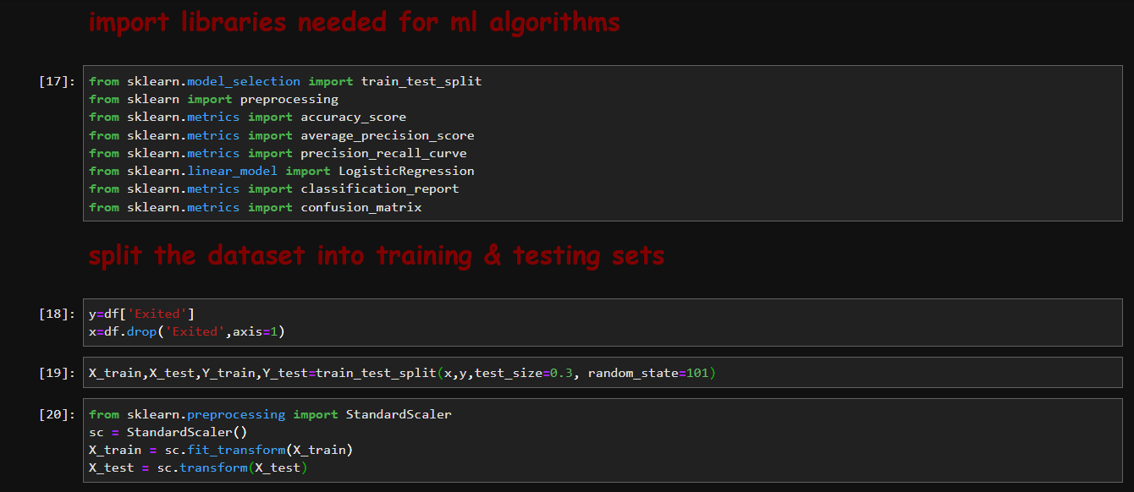
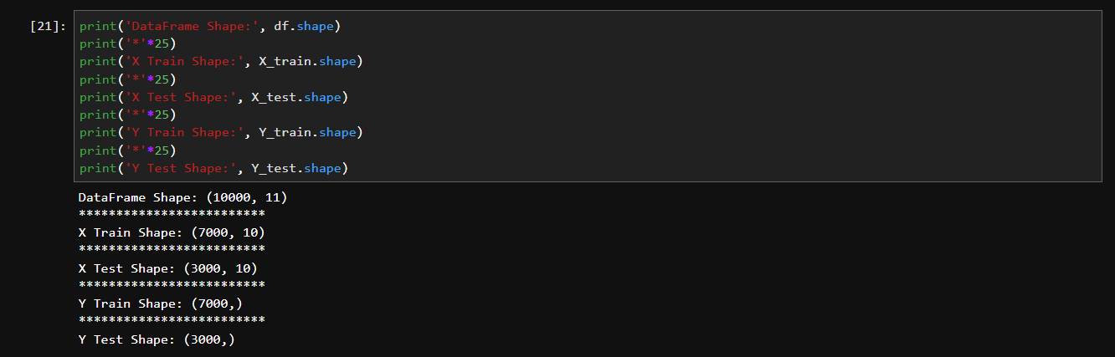

Slide 24
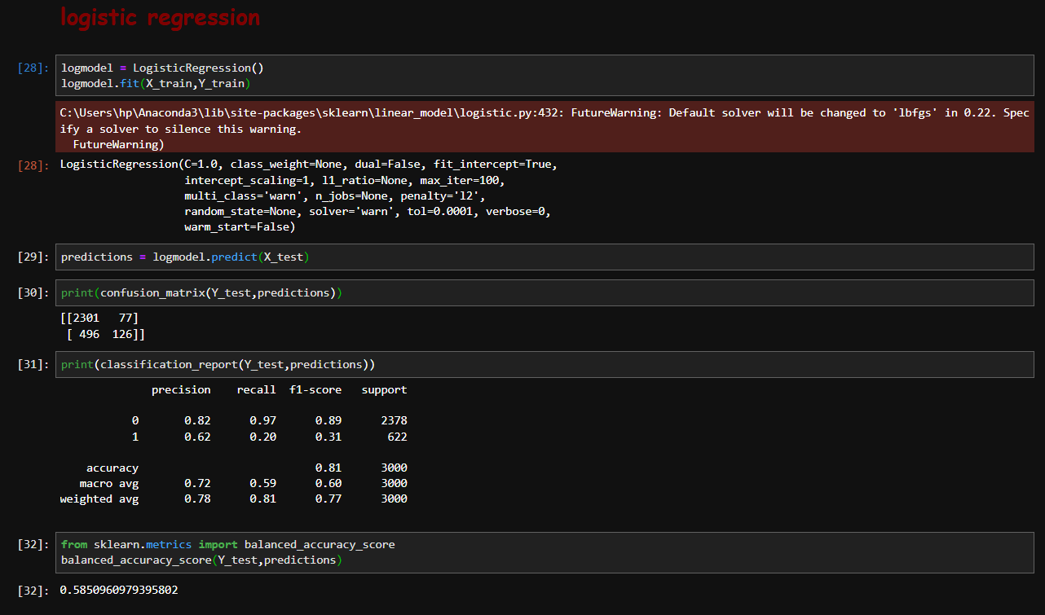

Slide 25
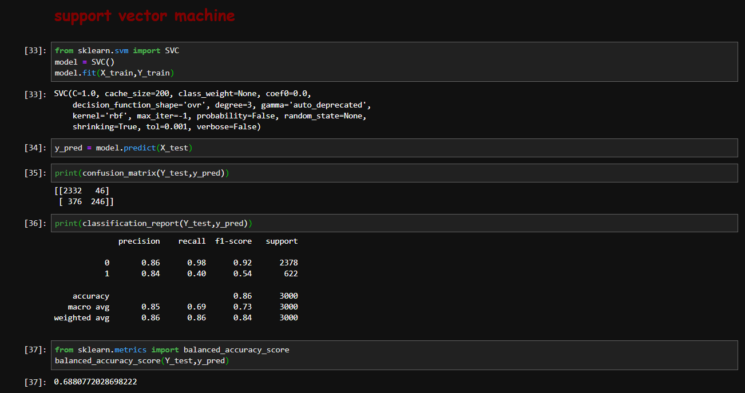

Slide 26
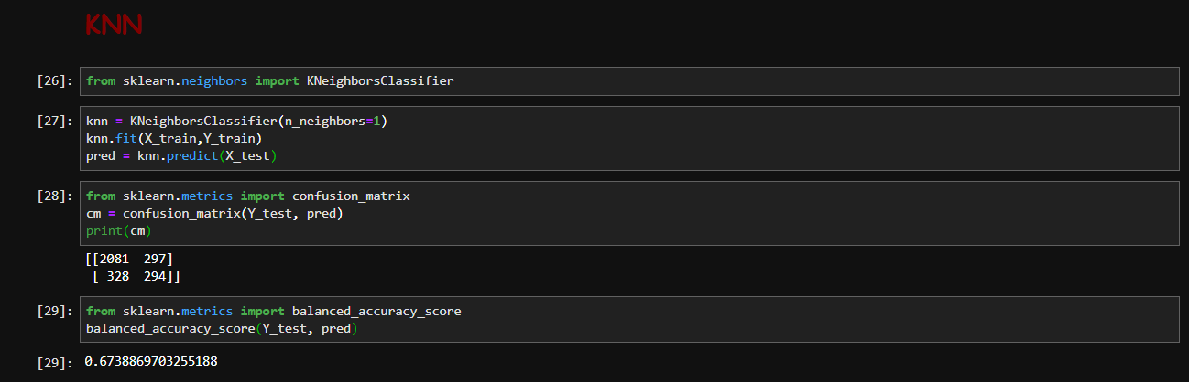

Slide 27
